Slide 1

Use AI to Predict Labor Markets
Team Gryffindors
Sponsored by:
Allwyn Corporation
Washington DC
Under Guidance:
Isaac K. Gang, PhD
College of Engineering & Computing
MS Data Analytics Program, C4I & Cyber

Slide 2

Team Members

Slide 3

Allwyn Corporation
Founded in the year 2003
It is headquartered in the Washington DC metro area.
Their main goal is helping organizations start with data transformation and drive towards operational transformation, using analytics and AI

Slide 4

Problem Statement
Develop a cost estimate for a project based on current labor market rates and predict labor market rates for the future 3-5 years.
Problem Context:
Domain of problem: Supply and Demand, Economy
Importance of problem:
Predicting labor markets will help in better decision making for contracts.
It can influence business outcomes.
Users will be able to see detailed level information on how the estimate was made.

Slide 5





Project Overview
Problem Understanding
Data Extraction
Data Preparation
Modelling
Salary Prediction

Slide 6
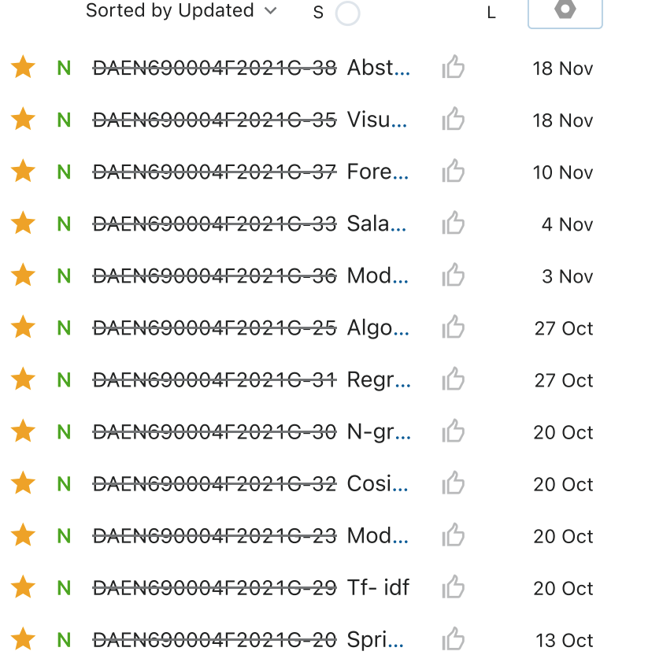
Agile Boards
Sprint 1- 6 user story cards
Sprint 2- 5 user story cards
Sprint 3- 6 user story cards
Sprint 4- 6 user story cards
Sprint 5- 9 user story cards

Slide 7
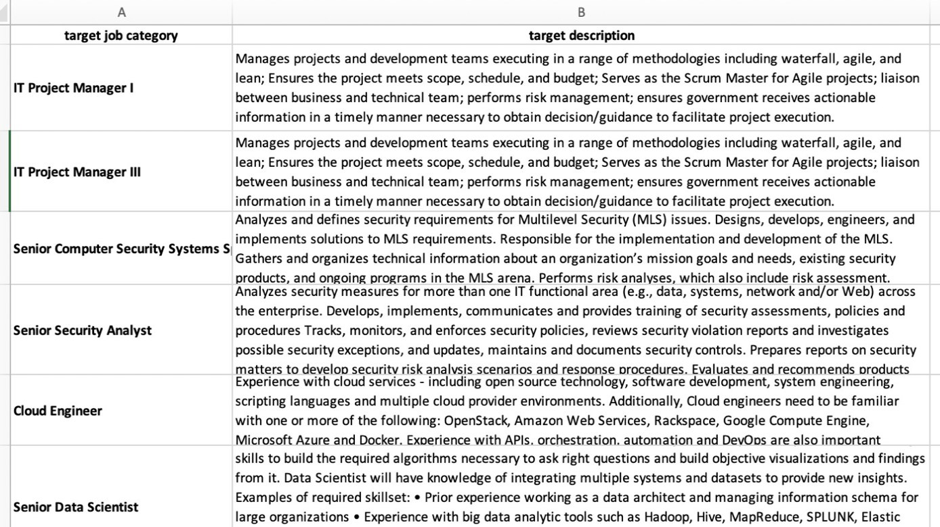
Data- Allwyn Corporation
Labor Category
Job Description
IT Project Manager I
IT Project Manager III
Senior Computer Security Systems Specialist
Senior Security Analyst
Cloud Engineer
Senior Data Scientist
User Experience (UX) Developer
Software Developer I
Software Developer III
Test Automation Engineer

Slide 8

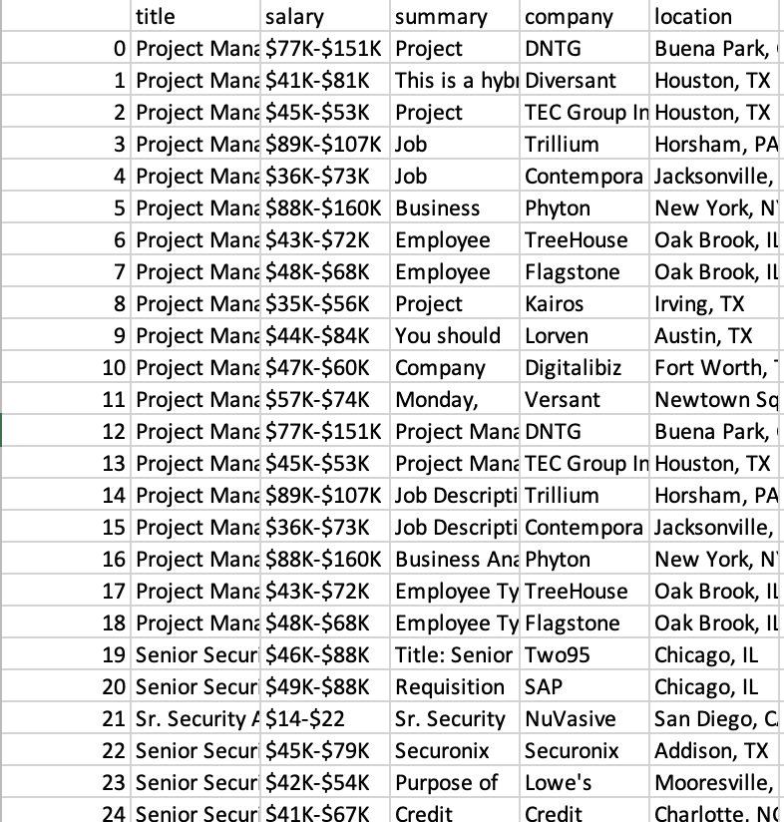
Dataset Name
Glassdoor
Dataset Owner
Kaggle[Glassdoor]
Dataset Size
5 MB
Dataset Time range
Current data captured which was captured1yrs back
Analytics/Algorithm that will use dataset
NLP
ML Models

Slide 9

Dataset Name
Indeed
Dataset Owner
Indeed
Dataset Size
3 MB
Dataset Time range
Current data dated 2-3 months back
Analytics/Algorithm that will use dataset
NLP
ML Models

Slide 10
ANALYTICS
Natural language Processing
There are two methods we used to match the actual job titles( provided by Allwyn corporation) with the dataset we compiled.
Cosine similarity on TF_IDF vectors.
Latent semantic analysis.
Cosine similarity on TF_IDF vectors:
First the description column in the went through some initial pre-processing steps:
Removal of punctuations
Tokenization
Removal of stop words
Lemmatization.
After pre-processing both the descriptions from the datasets. Vectors of important words were created from the description and summary column from both datasets simultaneously.

Slide 11
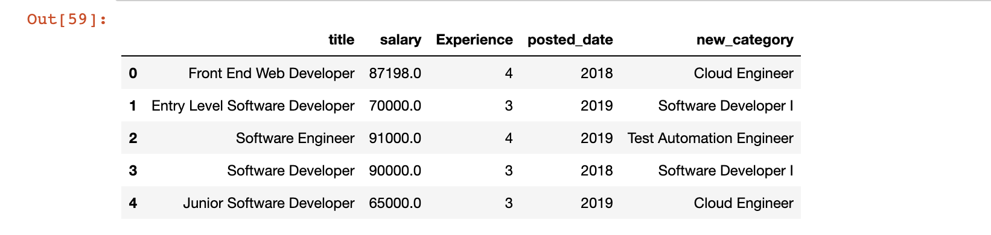
Cosine Similarity
Vectors:
Allwyn dataset vector: (10,235)
Our dataset vector: (9996,235)
After applying Cosine Similarity and replacing the job titles with highest similarity value:

Slide 12
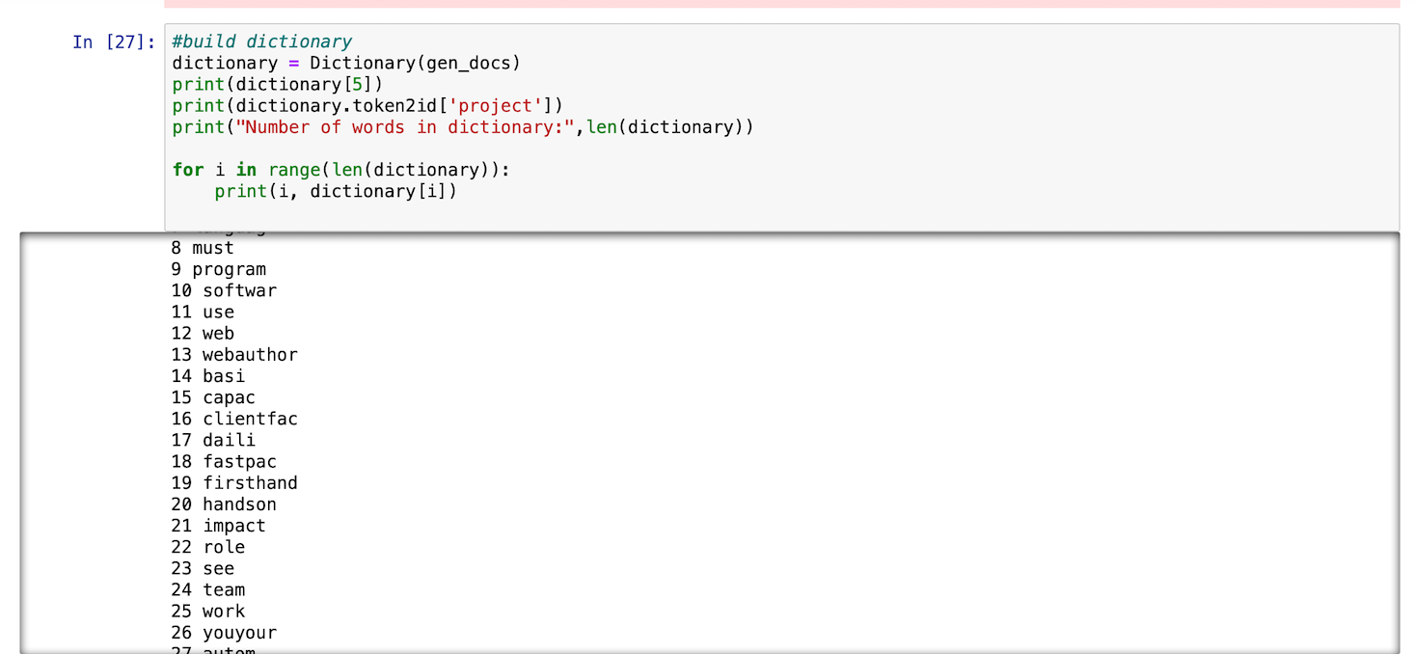
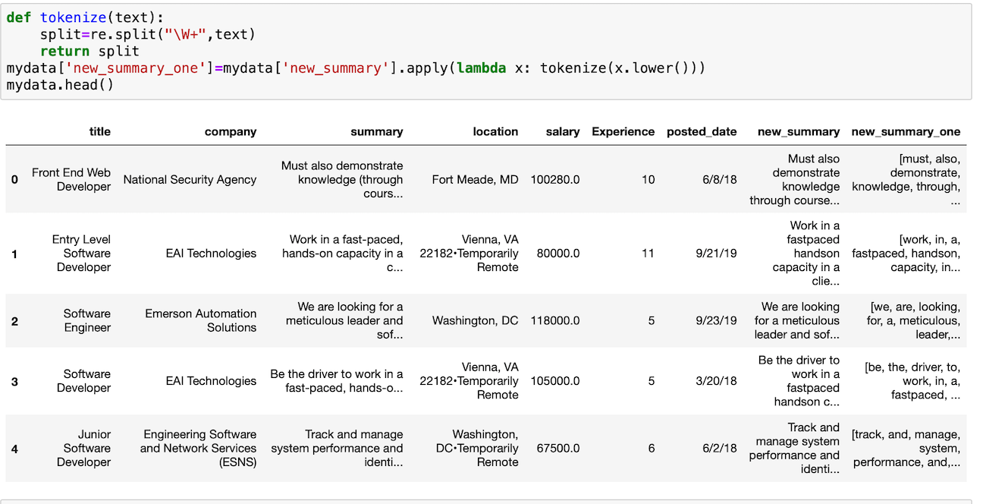
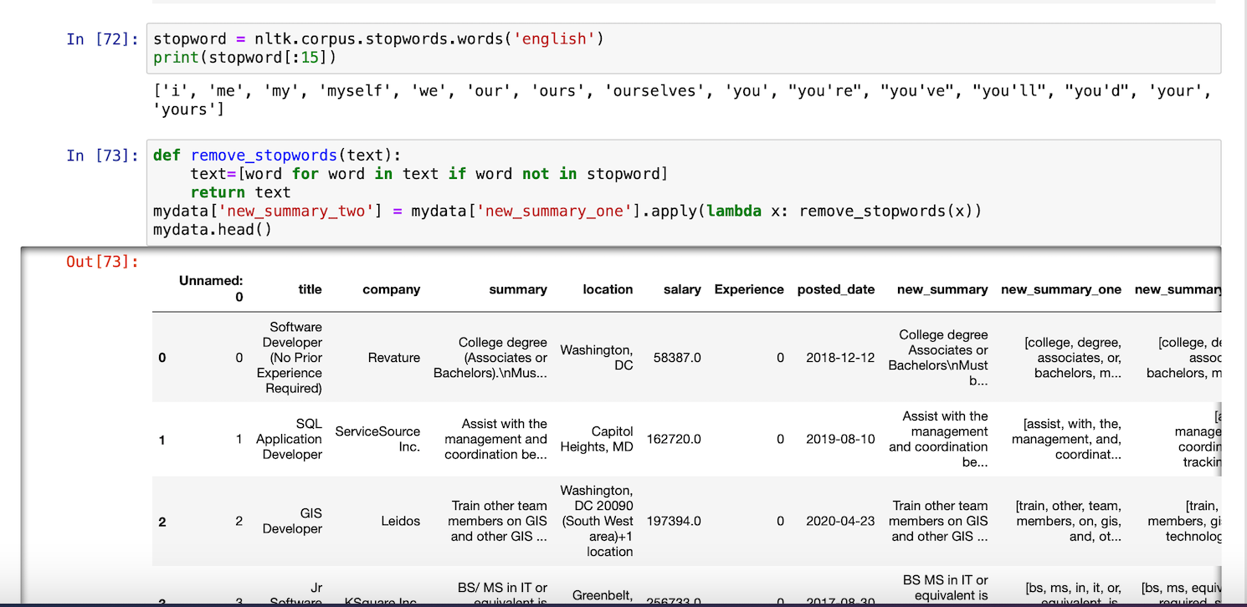
Latent Semantic Analysis Model
Step 3: Building Corpus
Results from Latent semantic Analysis(LSI)
Step 2: Tokenization
Step 1: Removing stop words

Slide 13
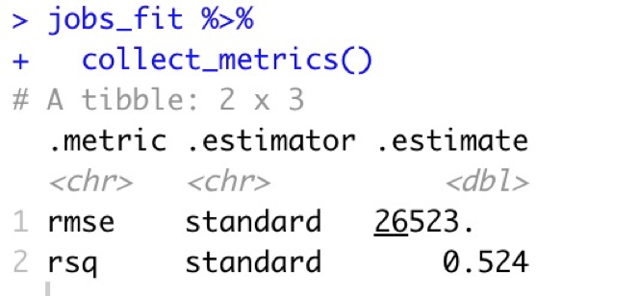
Linear regression
•Name: Linear Regression
•How it works: Based on the training data we predict the salaries on the test dataset and find the accuracy.
•Data Inputs: Test and Train datasets, Which we obtained by transforming the data.
•Model Tuning: Done
•Model Training Resources Required: Laptop
•Model Deployment: Done

Slide 14
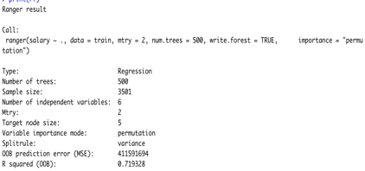
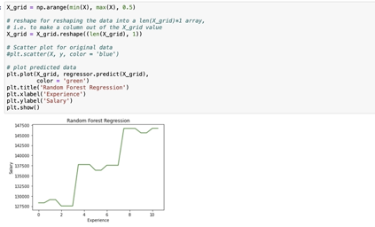
Random Forest
•Name: Random Forest Regression
•How it works: Based on the training data we predict the salaries on the test dataset and find the accuracy.
•Data Inputs: Test and Train datasets, Which we obtained by transforming the data.
•Data Outputs: Predicted values for salary
•Model Tuning: done
•Model Training Resources Required: Laptop
•Model Deployment: done

Slide 15
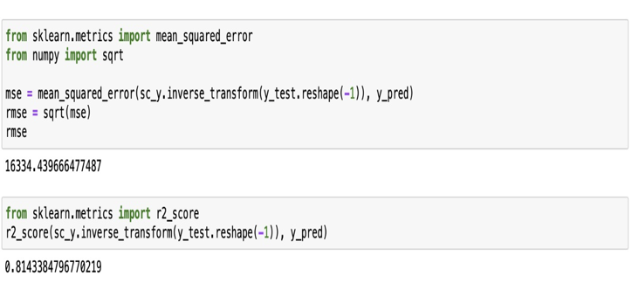
SVM
•Name: Support vector Machine
•How it works: Based on the training data we predict the salaries on the test dataset.
•Data Inputs: Test and Train datasets, Which we obtained by transforming the data.
•Data Outputs: Predicted values for salary
•Model Tuning: done
•Model Training Resources Required: Laptop
•Model Deployment: done

Slide 16
Machine Learning Models Results
We have built Random regression, Linear regression and Support Vector Machine models for the matched data. The features used for salary prediction are experience, posted date.
Below are the model results
MODEL | RMSE/annum | R-Square
Random forest | 37694.46 | 13.47%
Random forest (with k-fold validation=5) | 37492.33 | 13.80%
Linear Regression | 26523 | 52.4%
Support Vector Machine | 16335 | 81.0%

Slide 17
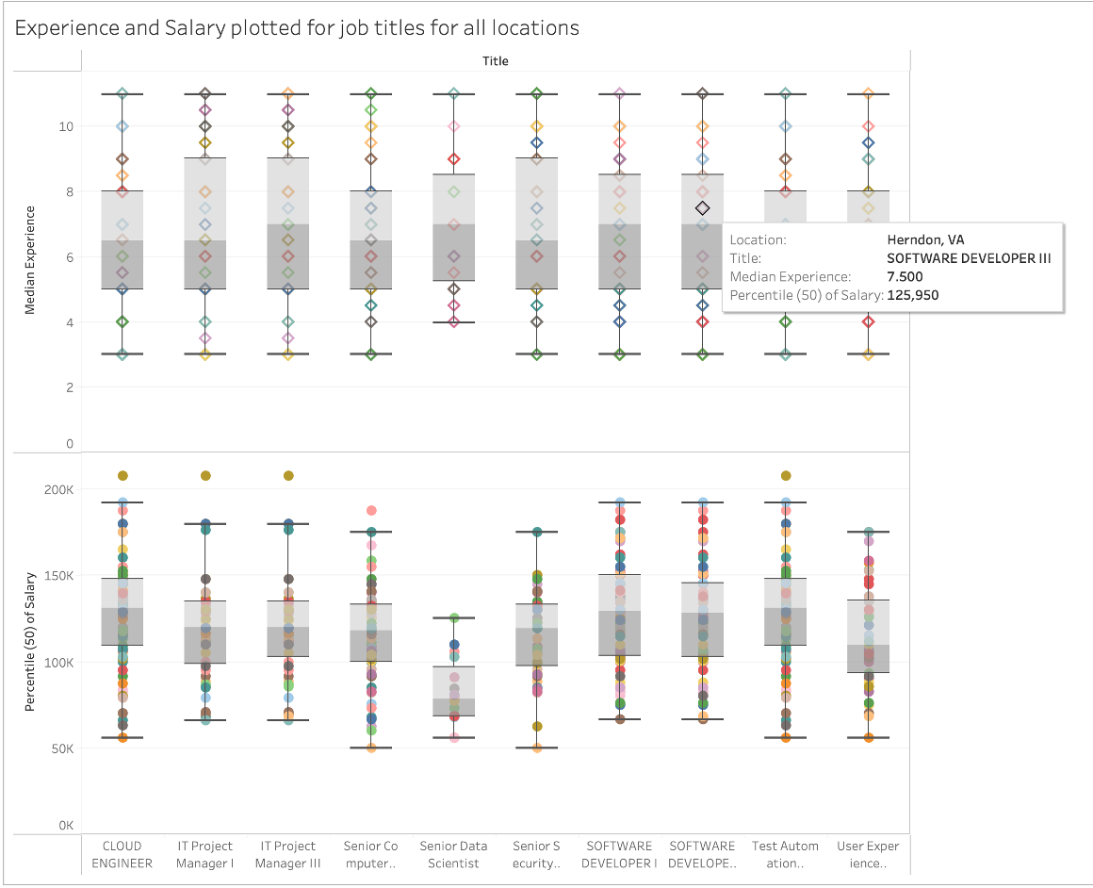
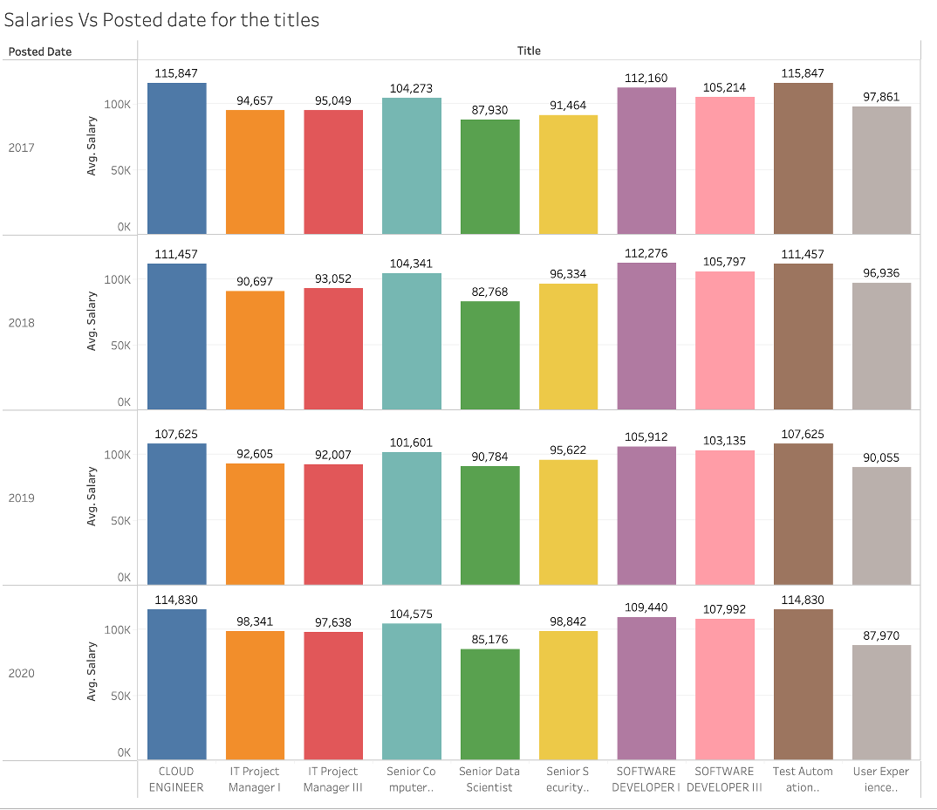
Visualization

Slide 18
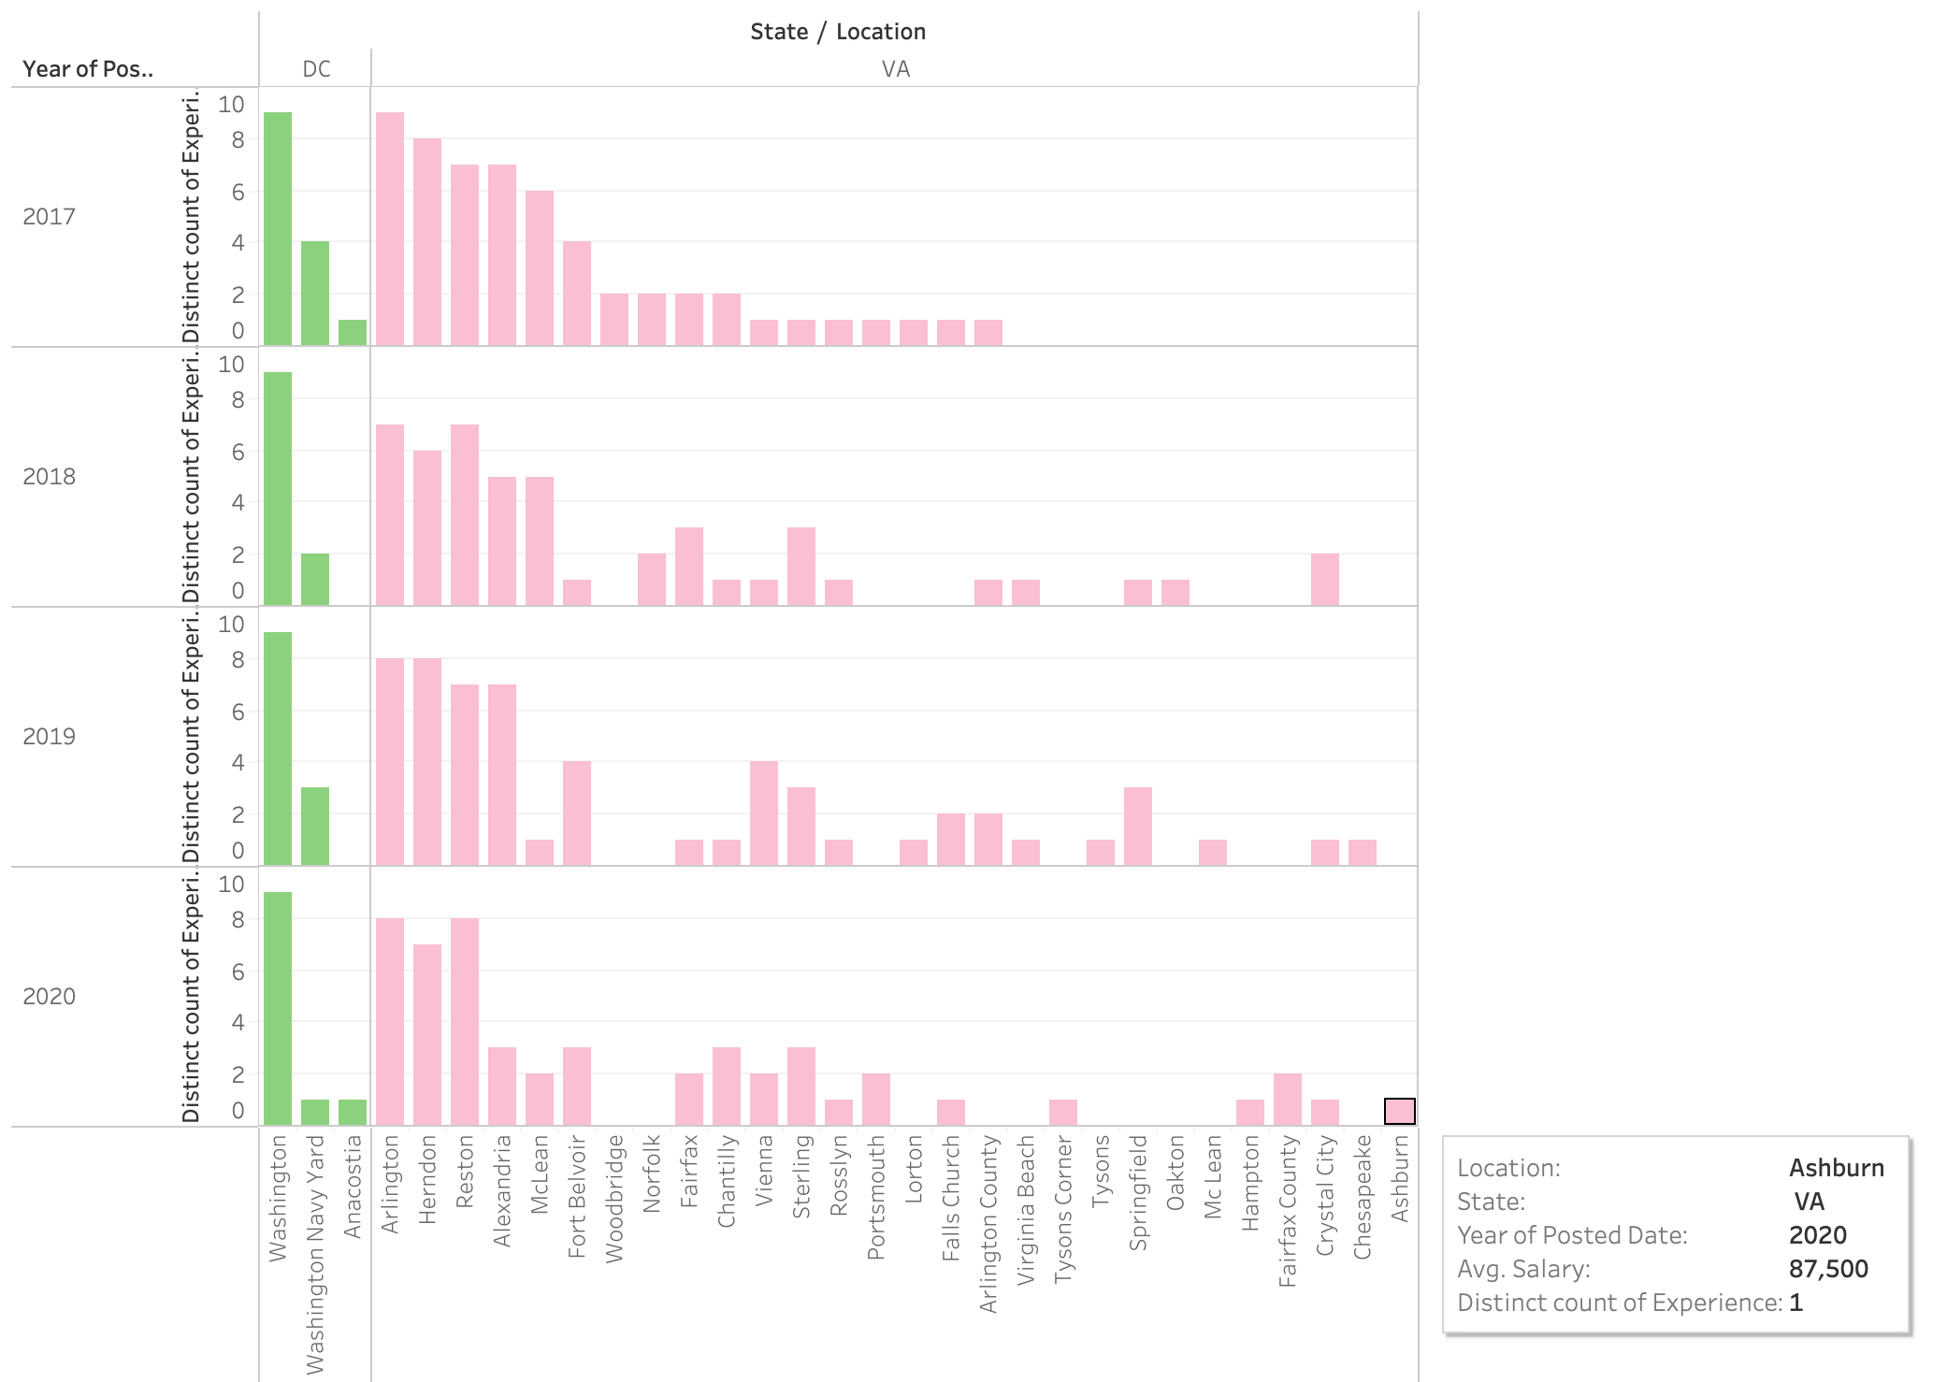
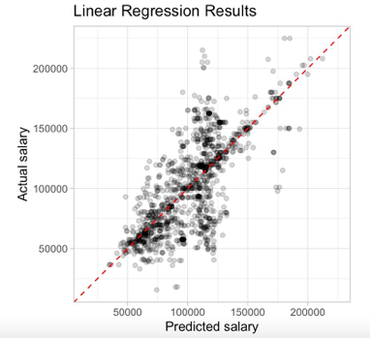

Slide 19
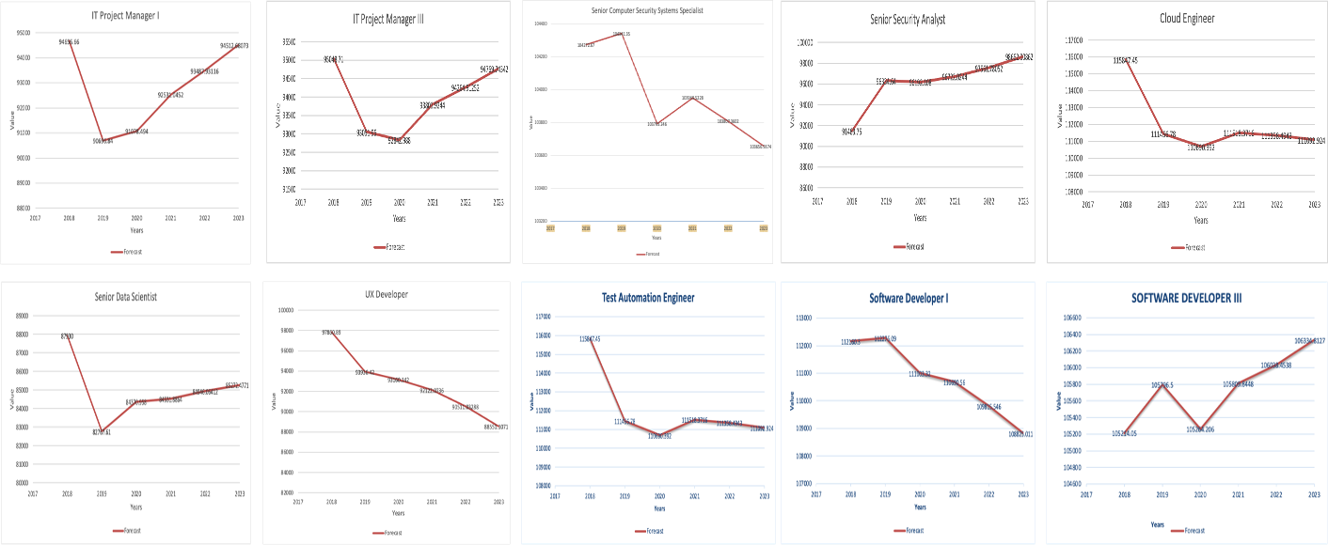
Exponential Smoothing

Slide 20

Summary
The best ML model for our dataset is SVM model.
After the prediction for the next few years, we found that few labor categories average salaries are increasing and few are decreasing.
Test Automation Engineer and Cloud Engineer have the highest salaries compared to any other labor category

Slide 21
Limitations
Recommendations
Data sources
Lack of historical data
Web Scrape data for every two months from legit sources like LinkedIn, indeed and glass door to store historical data.
Get datasets for labor market rates in IT labor market industry from paid sources to get more efficient results.
GitHub Repository
https://github.com/Sahithi0664/DAEN-Project

Slide 22
Any Questions?

